Slide 1
“Data”

Slide 2
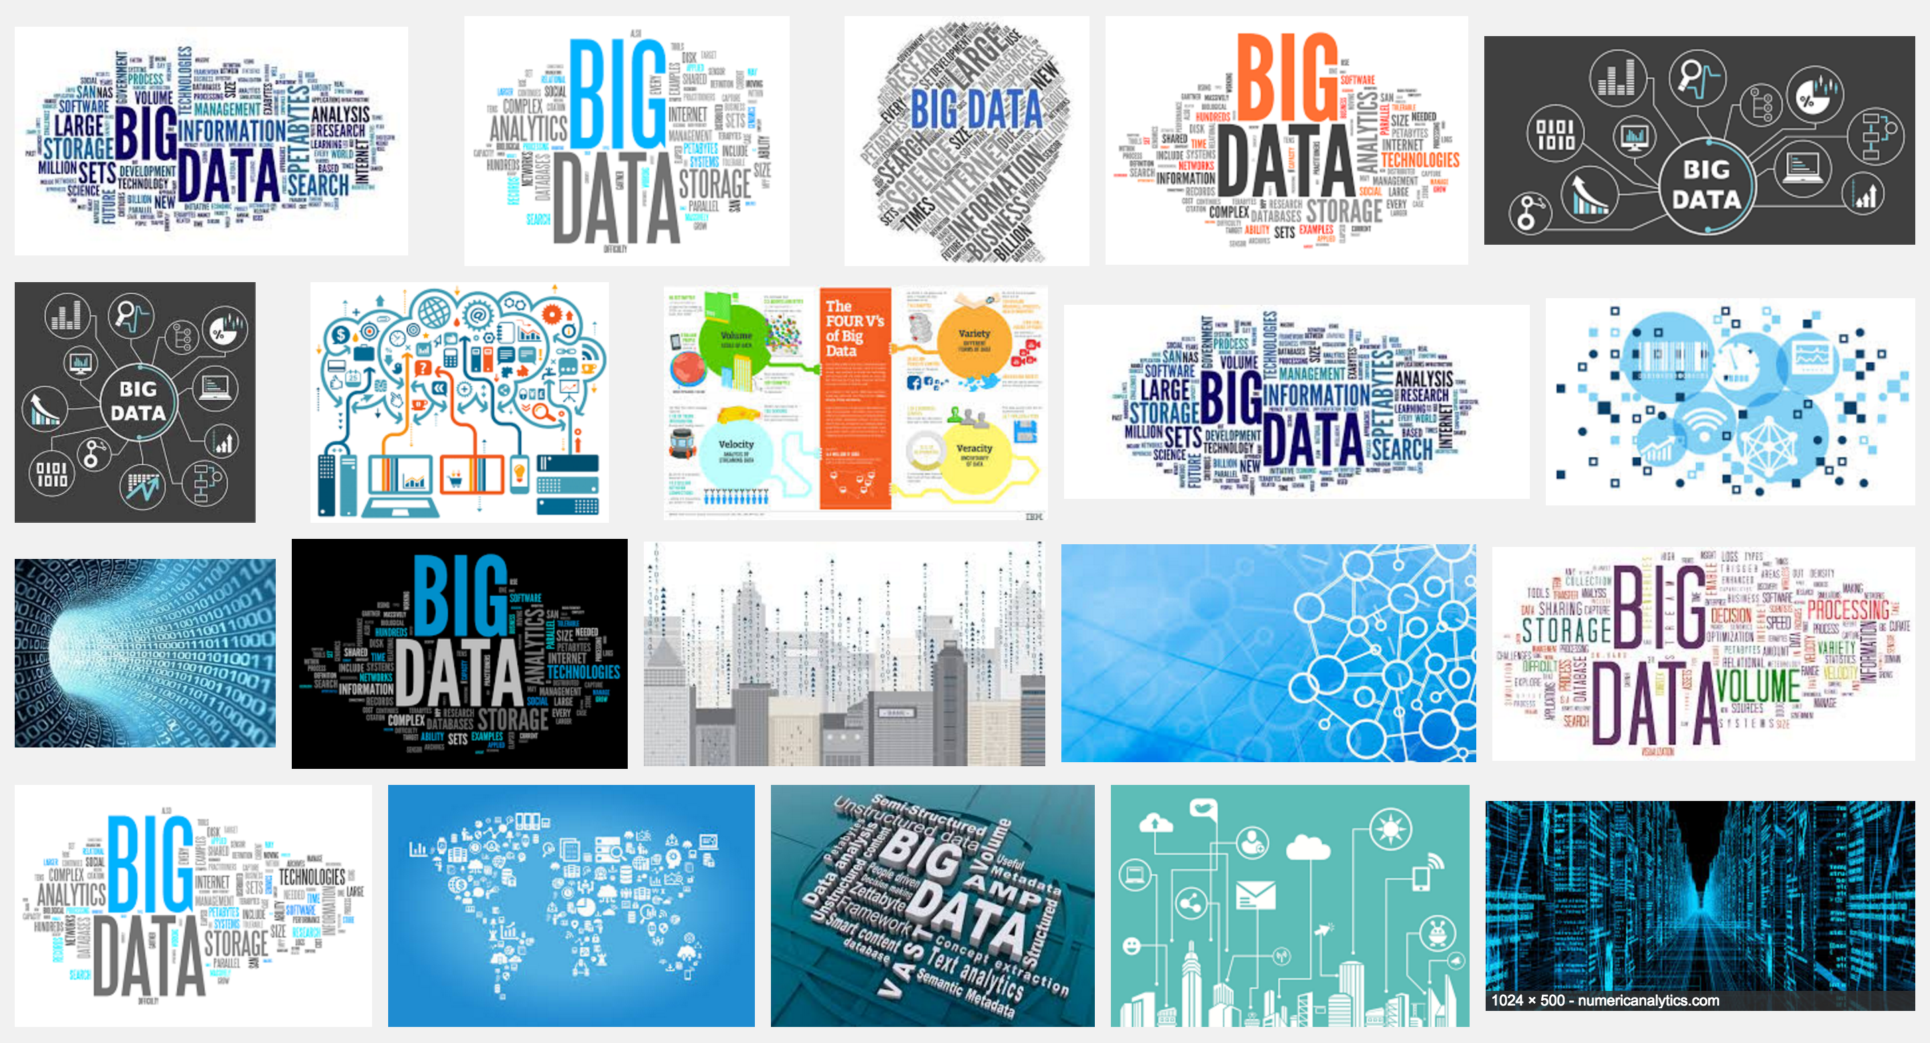

Slide 3
Ready-made vs. custom-made
Data following individuals vs. large datasets on organizations

Slide 4
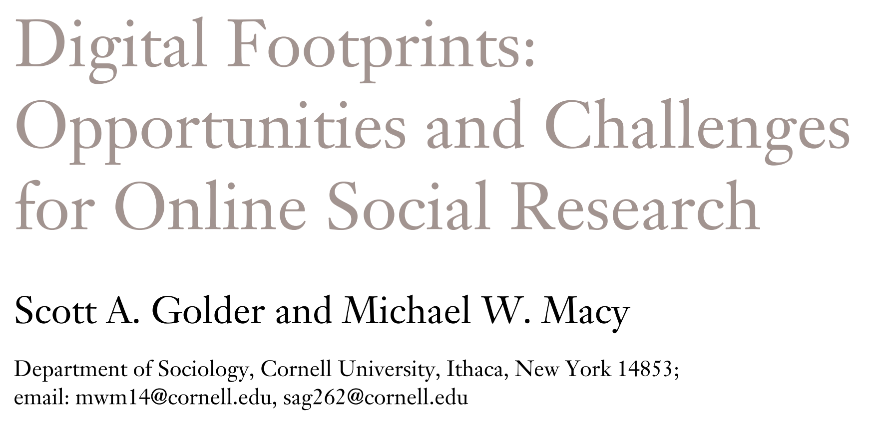
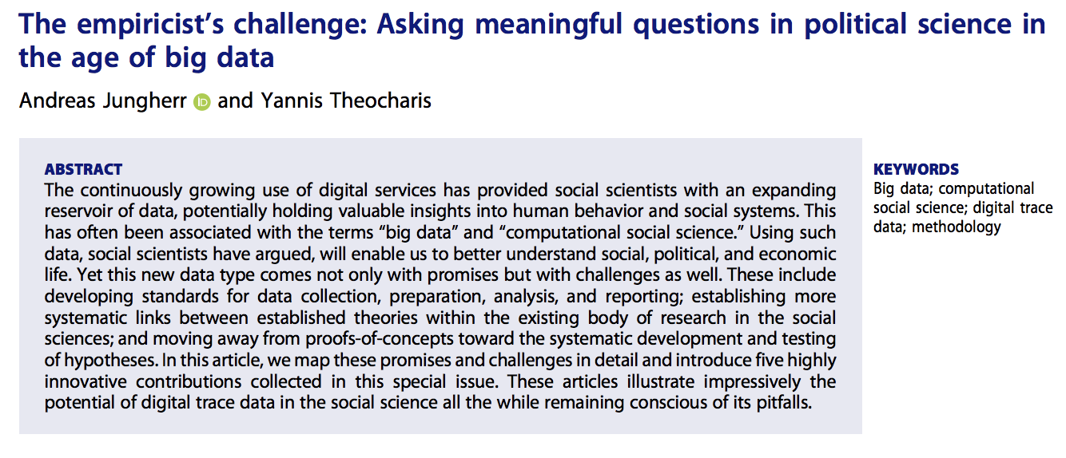

Slide 5
Different levels of digital traces
Your context at any given time
Each key pressed
Location of the cursor at any given time
Each page visited by the user during a session
Each message sent to the system by each user
Granularity

Slide 6
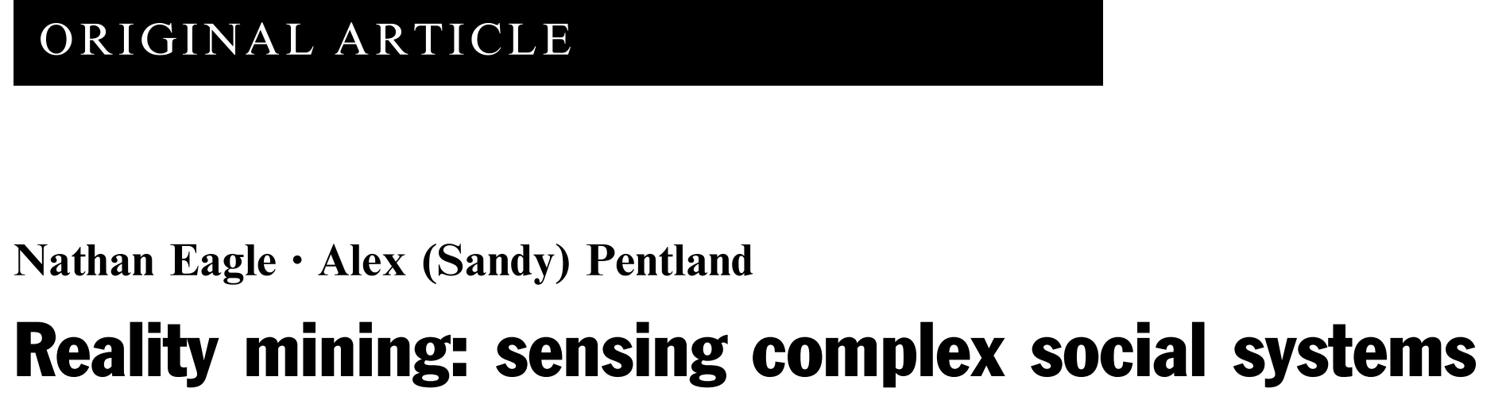
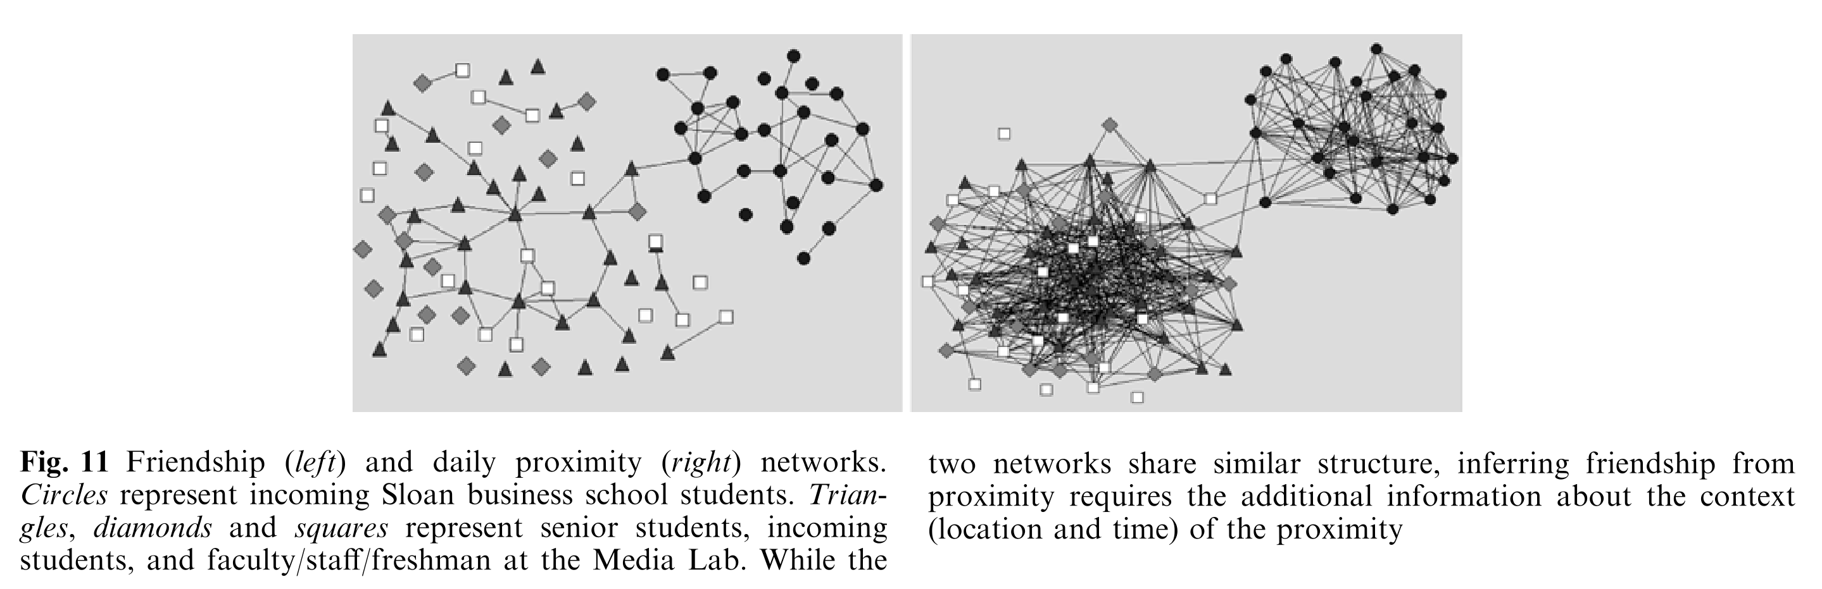

Slide 7
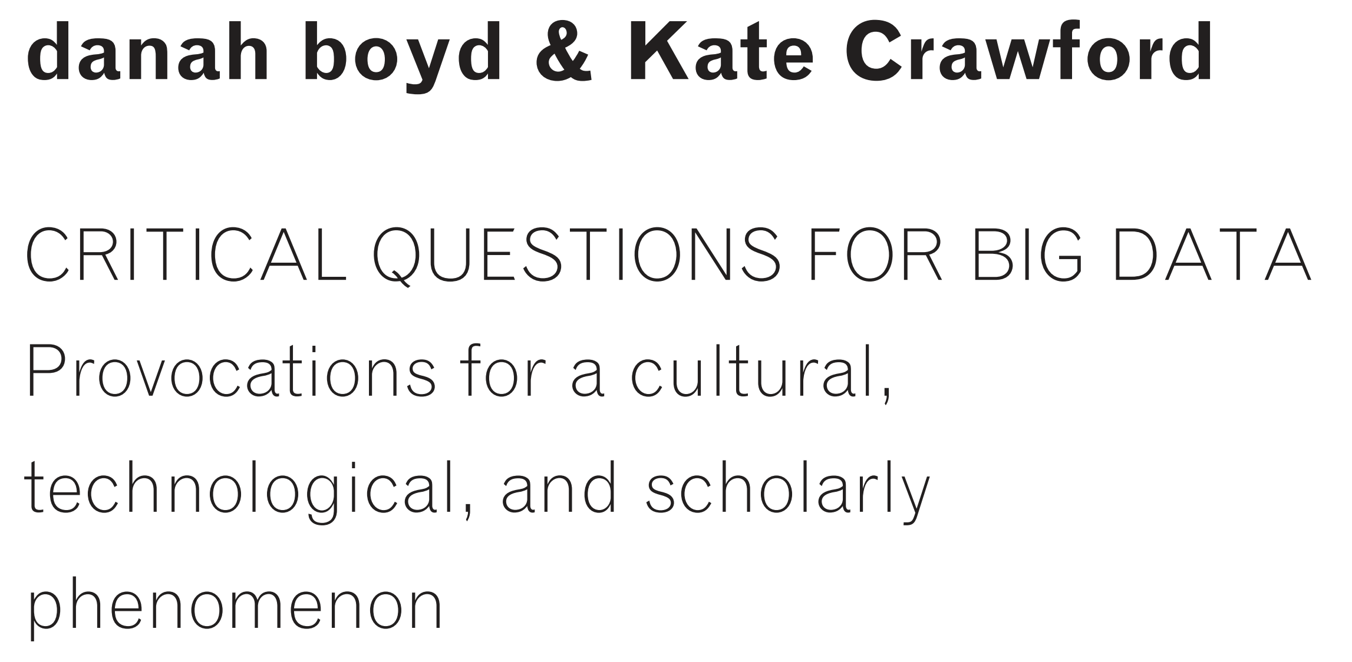
Claims to objectivity and accuracy are misleading
﻿Taken out of context, Big Data loses its meaning
﻿Limited access to Big Data creates new digital divides

Slide 8
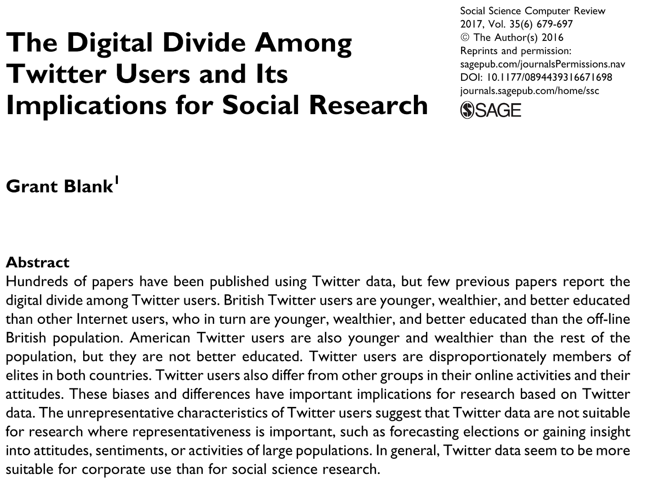

Slide 9
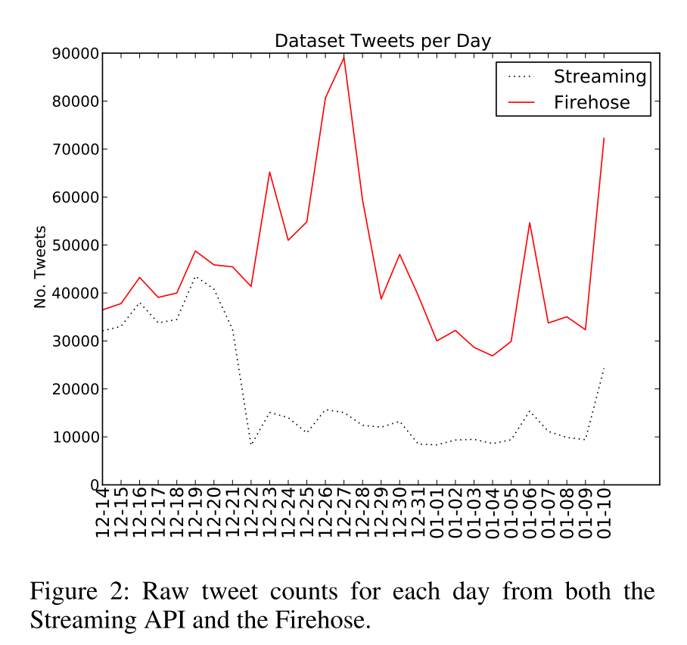
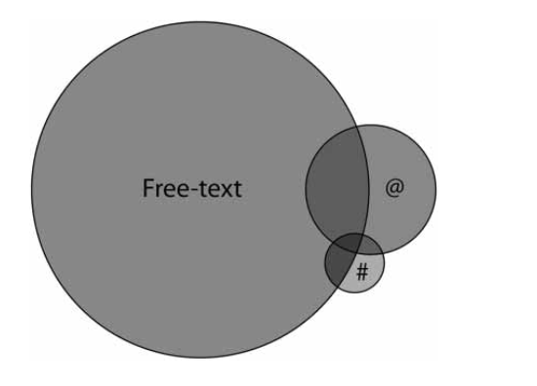
McKelvey, K., DiGrazia, J., & Rojas, F. (2014). Twitter publics: how online political communities signaled electoral outcomes in the 2010 US house election. Information, Communication & Society, 17(4), 436–450. https://doi.org/10.1080/1369118X.2014.892149
Joseph, K., Landwehr, P. M., & Carley, K. M. (2014). Two 1%s Don’t Make a Whole: Comparing Simultaneous Samples from Twitter’s Streaming API. In Proceedings of the Seventh International AAAI Conference on Weblogs and Social Media (pp. 75–83). https://doi.org/10.1007/978-3-319-05579-4_10

Slide 10
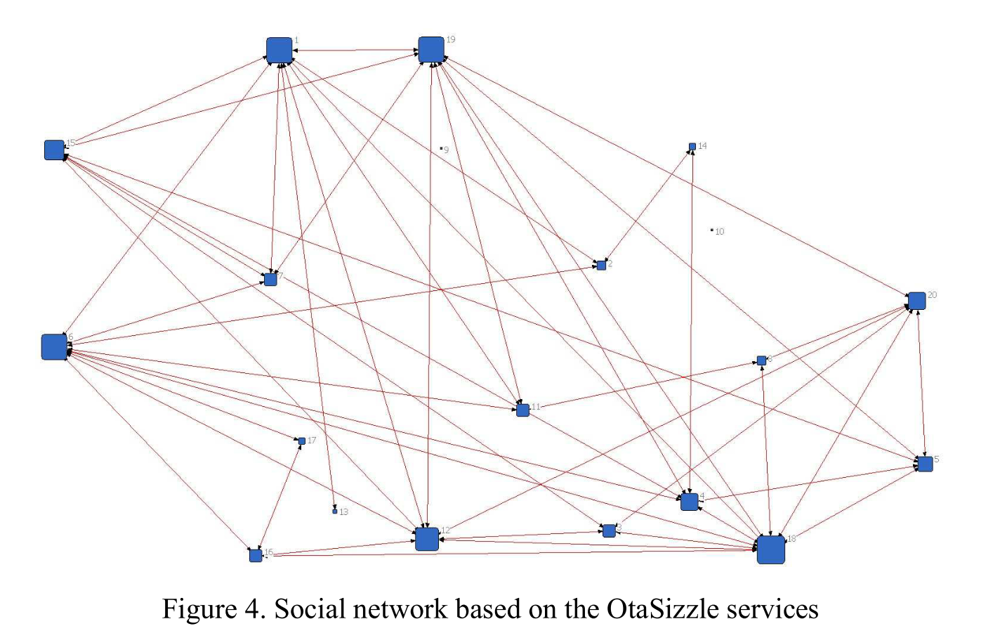
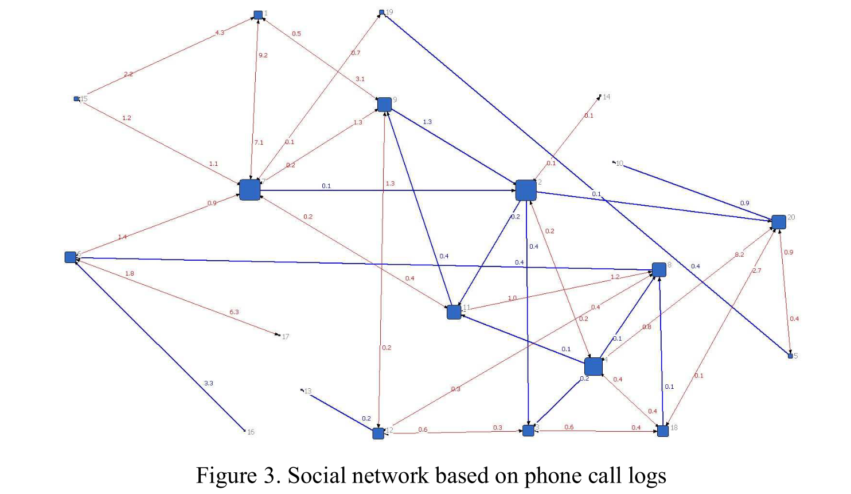
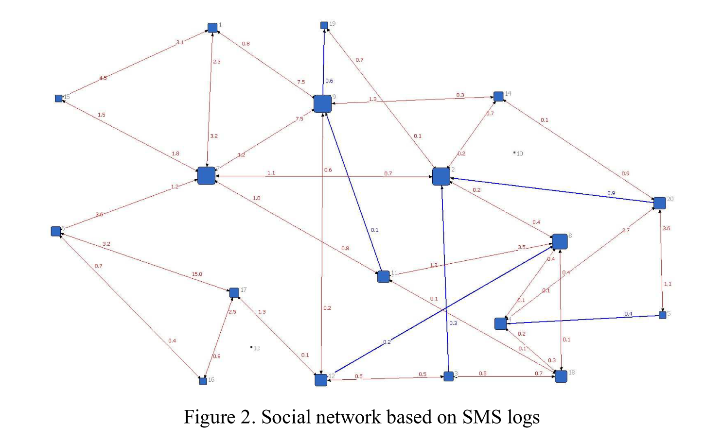
Instant messaging
Call logs
Online networks
Karikoski, J., & Nelimarkka, M. (2010). Measuring Social Relations: Case OtaSizzle. In 2010 IEEE Second International Conference on Social Computing (pp. 257–263). IEEE. https://doi.org/10.1109/SocialCom.2010.43

Slide 12
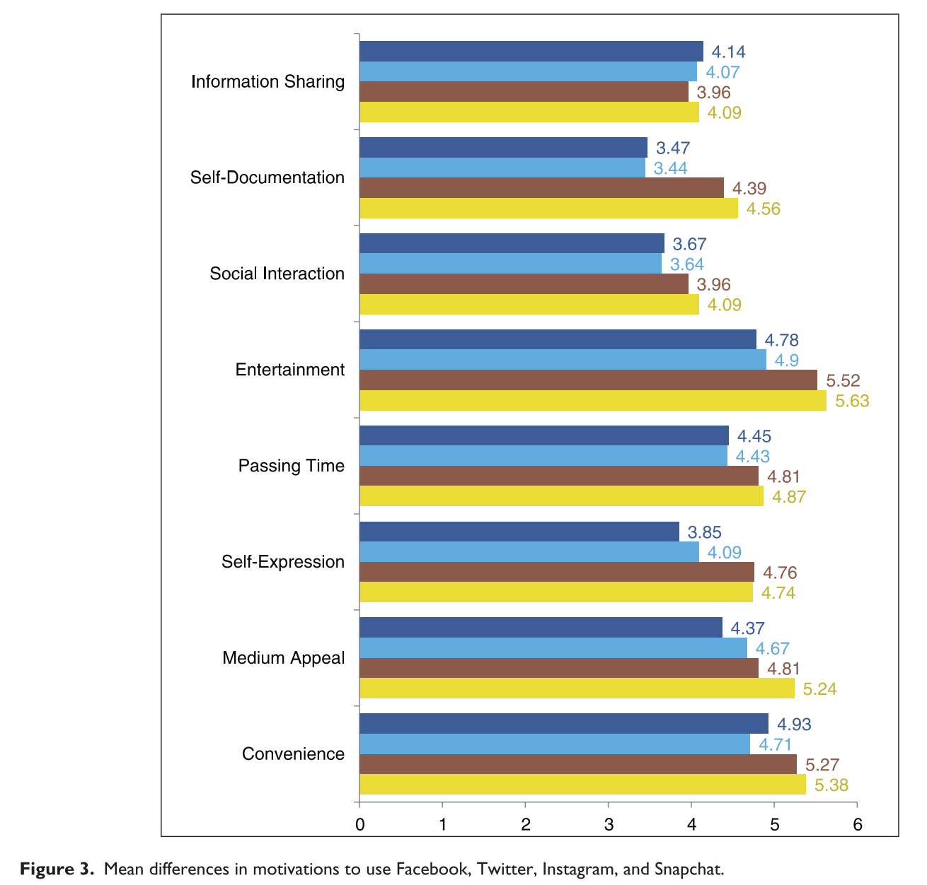
Alhabash, S., & Ma, M. (2017). A Tale of Four Platforms: Motivations and Uses of Facebook, Twitter, Instagram, and Snapchat Among College Students? Social Media + Society, 3(1), 205630511769154. https://doi.org/10.1177/2056305117691544

Slide 13
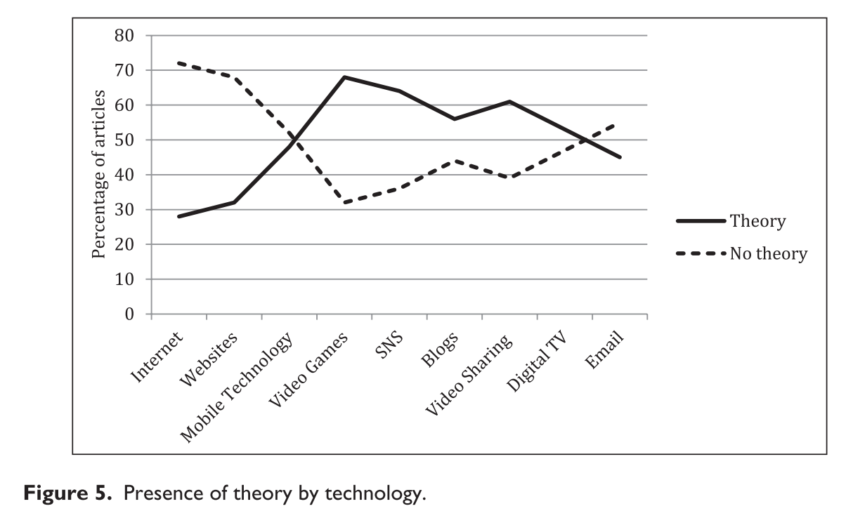
Majority of the articles (69.6%) did not use a specific theory in the study (N = 2311).
Borah, P. (2017). Emerging communication technology research: Theoretical and methodological variables in the last 16 years and future directions. New Media & Society, 19(4), 616–636. https://doi.org/10.1177/1461444815621512

Slide 14
Laaksonen, S.-M. M., Nelimarkka, M., Tuokko, M., Marttila, M., Kekkonen, A., & Villi, M. (2017). Working the fields of big data: Using big-data-augmented online ethnography to study candidate–candidate interaction at election time. Journal of Information Technology and Politics, 14(1), 110–131. https://doi.org/10.1080/19331681.2016.1266981

